Slide 1
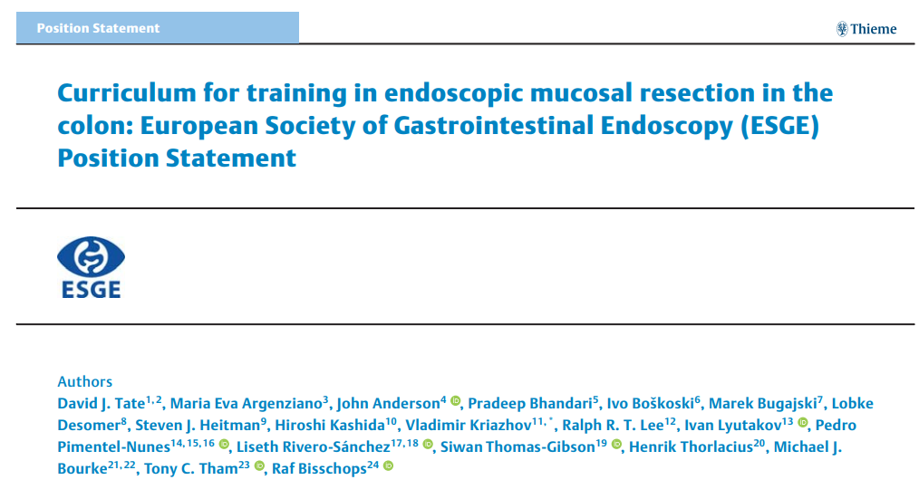

Slide 2
MAIN RECOMMENDATIONS
Endoscopic mucosal resection (EMR) is the standard of care for the complete removal of large (≥ 10mm) nonpedunculated colorectal polyps (LNPCPs).
Increased detection of LNPCPs owing to screening colonoscopy, plus high observed rates of incomplete resection and need for surgery call for a standardized approach to training in EMR

Slide 3
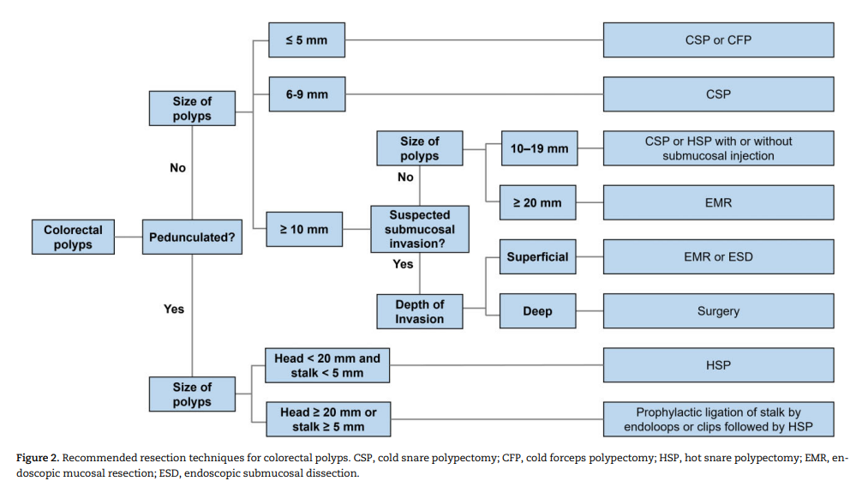

Slide 4
Introduction
Endoscopic mucosal resection (EMR) was first referred to by Dehyle in 1973 as a technique to remove rectal polyps transanally and later, in Japan, as a method for removing early gastric cancer.
It describes any diathermic resection of a gastrointestinal (GI) lesion using a snare with prior submucosal injection (hot snare EMR)
Over the years this definition was broadened to involve polyp resections that did not require electrosurgical energy (cold snare EMR )

Slide 5
EMR is the preferred technique to remove flat and sessile ≥ 10-mm polyps in the colon.
It is safe and effective with significantly lower cost morbidity, and mortality . compared with surgical resection.

Slide 6
This curriculum was developed through a Delphi consensus process amongst international experts in EMR

Slide 7
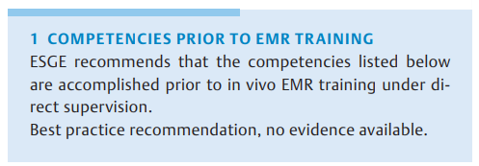

Slide 8
Competency in diagnostic colonoscopy (as defined by local protocols)
Commencement of acquiring theoretical knowledge, such as lesion assessment and decision-making
(iii) Competency in < 10-mm polypectomy (with and without electrosurgical energy), pedunculated polypectomy, and common methods of GI endoscopic hemostasis [17] (as defined by local protocols

Slide 9
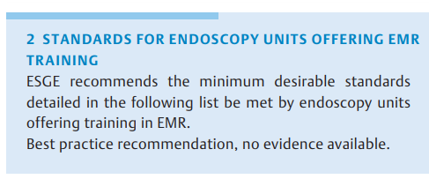

Slide 10
Written and/or electronic pre-procedure pathways should exist to facilitate the assessment of patients with co-morbidity prior to EMR.
(ii) Written local pre-procedure pathways should exist to direct the correct dosing of anticoagulants for patients prior to EMR based on international consensus guidelines.

Slide 11
(iii) Formal procedures should exist, either via written information, remote consultation, or face-to-face discussion, to communicate specific information to the patient prior to the procedure, particularly to facilitate excellent bowel preparation. Level of agreement 96 %.
(iv) Administrative staff booking complex EMR procedures must have guidance to ensure adequate time and personnel are allocated for the scheduled procedure relative to its predicted complexity, perhaps using a validated score, such as the size, morphology, site, and access (SMSA) polyp score [18] for guidance. Extra time should be allocated if training is foreseen. Level of agreement 96 %.

Slide 12
(v) Units should have a mechanism in place for the training of nursing staff in the techniques and equipment required for EMR and in how to assist the proceduralist. Level of agreement 96 %.
(vi) There should be a dedicated anesthesia-supported list in the unit performing EMR for complex and/or predicted protracted EMR cases (e. g. very large resections, predicted difficult location etc.). Level of agreement 90 %.

Slide 13
(vii) All necessary equipment should be available prior to starting an EMR procedure. Equipment checklists should be available and used within the unit to ensure this is the case. Level of agreement 96 %.
(viii) Image and/or video capture equipment for EMR procedures and the ability to record these in electronic reporting systems should be available. Level of agreement 95 %

Slide 14
(ix) There should be immediate on-site access to support services (including interventional radiology and surgery) in the event of a significant bleed or other complication (e. g. perforation), or a pathway should exist for rapid transfer to a specialist center. Level of agreement 90 %.
(x) There should be a dedicated recovery room in the unit able to monitor patients at a high level for an extended period of time and allow admission to hospital if necessary. Level of agreement 94%.

Slide 15
(xi) Written emergency pathways should exist for the swift detection and resolution of adverse events after EMR. Level of agreement 97%.
(xii) There should be access to specialist GI pathologists with an interest in GI neoplasia. Level of agreement 96%.

Slide 16
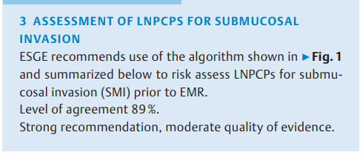

Slide 17
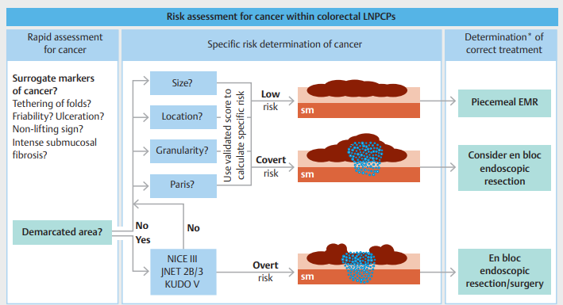

Slide 18
Illustration of the proposed stepwise approach to cancer detection within colorectal polyps.
First look for surrogate markers of cancer and the presence of a demarcated area. A demarcated area with a disordered vascular pattern implies the lesion is at very high or overt risk of cancer and should be considered for en bloc endoscopic resection or surgery (multidisciplinary decision).
If there is no demarcated area or the demarcated area contains no disordered vascular pattern, the four parameters of covert cancer risk should be determined to identify the covert risk of cancer and need for en bloc endoscopic resection.
LNPCP, large non-pedunculated colorectal polyp; EMR, endoscopic mucosal resection; Paris, Paris classification; sm, submucosa; NICE, Narrowband imaging International Colorectal Endoscopic classification; JNET, Japan NBI Expert Team. * Requires a multidisciplinary approach. SMI ,submucosal invasion

Slide 19
A demarcated area is a circumscribed area within a colorectal polyp where there is a definite change from one pit/vascular pattern to another.
If there is no demarcated area detectable (or the demarcated area is not disordered in pit/vascular pattern), perform a morphologic assessment (Paris classification , location, size, granularity) to assess the risk of covert SMI
In general, larger nongranular lesions in the rectum with large nodular components are at the highest risk of covert SMI.

Slide 20
The Paris Classification is an international standard for endoscopic classification of gastrointestinal superficial neoplastic lesions, adapted from the Japanese macroscopic classification for gastric cancer ¹ ⁵

Slide 21
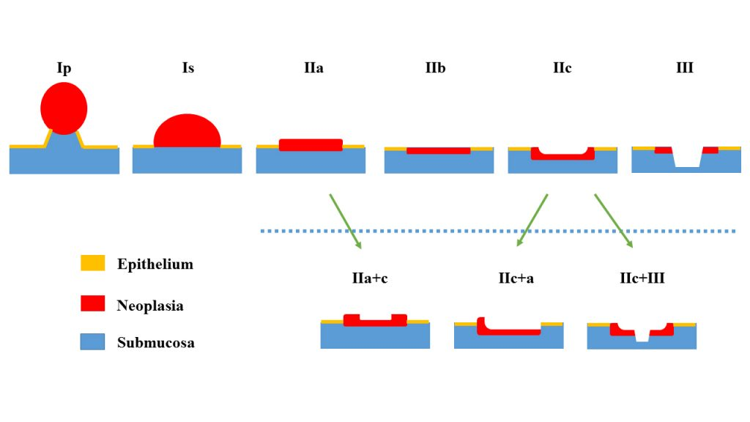
Paris classification:

Slide 22
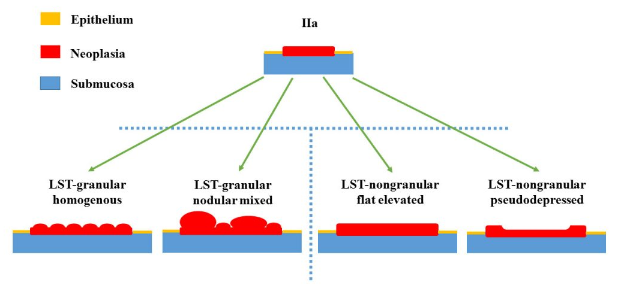

Slide 23
Kudo classification
Type I and II indicate non-neoplastic lesions,
Type IIIL, IIIs and IV indicate adenomatous,
Type VI and VN indicate cancerous.

Slide 24
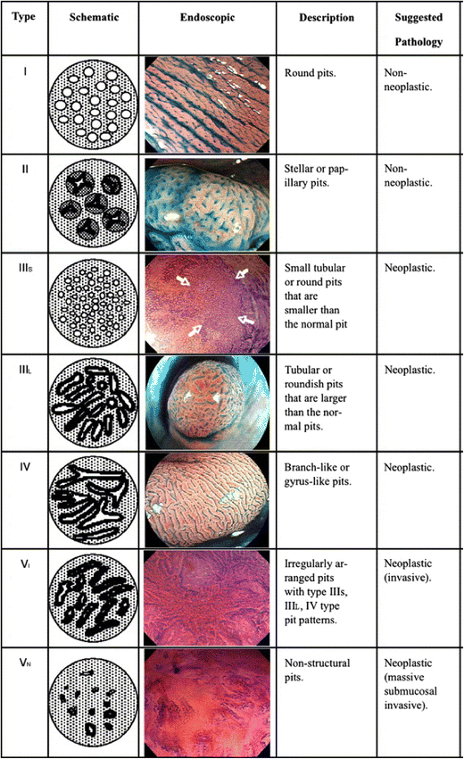

Slide 25
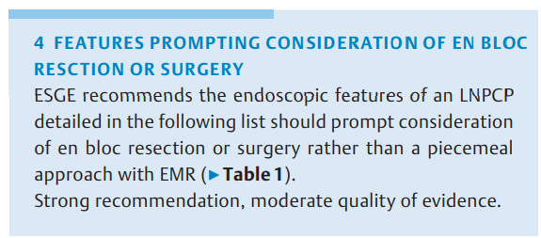

Slide 26
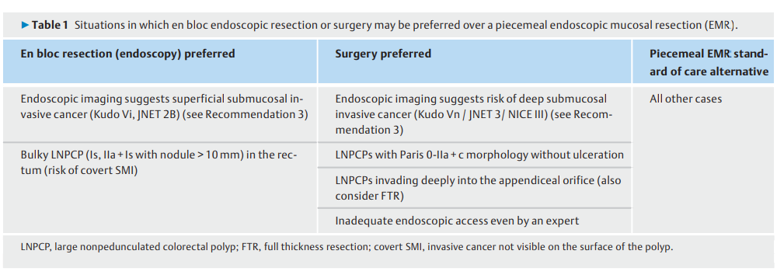

Slide 27
Endoscopic imaging features suggesting low risk superficial SMI (en bloc endoscopic resection) or deep SMI (surgery) . Level of agreement 93 %.
(ii) Any bulky (Is, IIa+Is with nodule > 10mm) lesion in the rectum or at the rectosigmoid junction (high risk for covert SMI) without endoscopic imaging features suggesting overt SMI (en bloc endoscopic resection) .Level of agreement 85 %.

Slide 28
Surgery:
Any LNPCP with Kudo Vn/JNET 3/NICE III pit/vascular pattern (surgery)
Any LNPCP with Paris 0-IIa+c or 0-III morphology and ulceration (surgery).
Periappendiceal LNPCPs invading deeply into the appendiceal orifice (defined by the inability to visualize the entire circumferential margin of the lesion) without prior appendicectomy (full-thickness resection/surgery)
Inadequate endoscopic access to the target lesion for EMR even by an expert in the technique (laparoscopically assisted EMR or surgery )

Slide 29
Comment In general, risk of SMI is the only evidence-based factor that should prompt a decision for en bloc resection in place of piecemeal EMR.
Residual or recurrent adenoma, given the efficacy of thermal ablation of the post-EMR margin ,should not be the sole reason to prefer an en bloc approach.
It is also possible to perform piecemeal EMR despite non-lifting (whether in a treatment-naïve or previously attempted/biopsied LNPCP, as long as the risk of cancer is regarded as low.

Slide 30
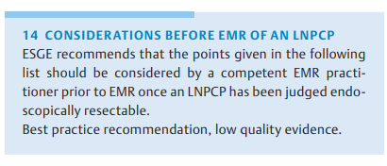

Slide 31
Adequate colon cleanliness according to the Boston Bowel Preparation scale (BBPS) or another similar scale. BBPS < 2 in the colonic segment containing the LNPCP for resection suggests inadequate preparation for EMR and an increased risk of failure and complications .Level of agreement 86 %.
(ii) LNPCPs with endoscopic imaging suggestive of overt superficial SMI or those with high risk of covert SMI should be considered for en bloc resection (see Recommendation 4). Level of agreement 95 %

Slide 32
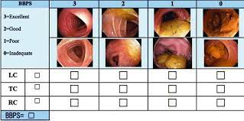

Slide 33
(iii) An alternative option for large nodules or small areas within LNPCPs suspicious for SMI is piecemeal resection with en bloc resection of the suspicious area for better pathology reporting.
(iv) En bloc EMR for LNPCPs ≥ 15mm (right colon) and ≥ 20mm (left colon) should not always be pursued at all costs when there is no overt and low covert risk of SMI, owing to the increased risk of intraprocedural complications (e. g. intraprocedural perforation [98]) without benefit in terms of adenoma recurrence .

Slide 34
(v) The endoscopist should consider their own capacity to complete the procedure on that occasion. the SMSA score (▶Table 2) can help in this determination. If there is doubt as to the competency of the endoscopist, or that the lesion can be fully resected in a single session, and the potential adverse events of such a resection managed, the endoscopist should not attempt resection and should consider referring the patient to an EMR specialist. Level of agreement 96 %.

Slide 35
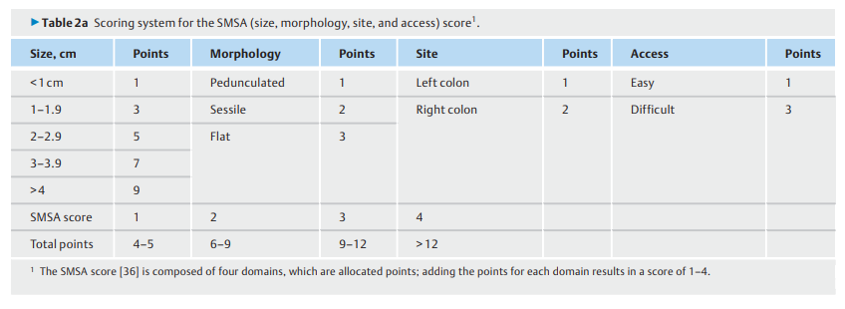

Slide 36
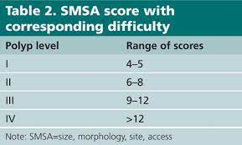

Slide 37
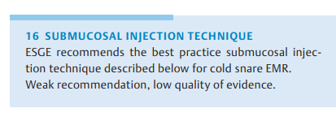

Slide 38
Use injection to improve lesion access and visualization
(ii) Ensure air is expelled from the injection catheter prior to first injection (priming).
(iii) Injection through clearly benign lesions is acceptable if necessary. Caution should be exercised when attempting injection through LNPCPs suspected of containing SMIC because of the risk of malignant seeding

Slide 39
(iv) Injection should be performed dynamically. The injection is started (short stab, tangential to the mucosa) as the tissue is being punctured and then the catheter is pulled back and lifted up/away in the desired direction
(v) Avoid intramucosal blebs (▶Fig. 2, image B4). If these occur, puncture them and re-attempt submucosal injection [113].
(vi) Stop the injection if no lifting is noted (likely transmural/ intraperitoneal injection).
(vii) Obtain an appropriate and sustained lifting of the lesion
(viii) Do not over-lift, especially in narrow segments (e. g. sigmoid colon) or at flexures.

Slide 40
(xiv) If the tissue is not transected after 5 seconds, the endoscopist should pull gently on the snare catheter so that the tissue abuts the tip of the endoscope (guillotine technique)
(xv) If the tissue still does not cut despite attempted use of the guillotine technique, the assistant is asked to slowly open the snare, while continuing gentle traction on the polyp. This usually leads to the mucosal specimen sliding over a submucosal protrusion.
(xvi) If the tissue still is not transected, the snare should be reopened and the procedure repeated.

Slide 41
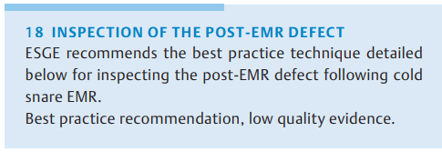

Slide 42
(ii) Topical application of a chromic dye (or the injectate if it contains a chromic dye) can be helpful for assessing the defect and the margin for residual adenoma after cold snare polypectomy [102] (▶Fig. 2, images D4 and D5.
(iii) The use of virtual chromoendoscopy and magnification can be helpful to detect residual polyp tissue at the defect margin.
(iv) Bleeding from within a cold snare polypectomy defect does not need treatment unless pulsatile.

Slide 43
Be aware that perforation of the muscularis propria after cold snare polypectomy is extremely rare and described only in case reports. This should be treated appropriately if it occurs.
Photodocumentation of all areas of the post-EMR defect (▶Fig. 2, images D1–D5) helps to assess the completeness of the resection. It may also be useful for medicolegal purposes.
The differences between the hot snare and cold snare techniques include the recommended use of a thick-wire snare (wire diameter > 0.4mm) for hot snare EMR.

Slide 44
The submucosal injection technique for hot snare EMR is similar to that for cold snare EMR; however, endoscopists should avoid attempting to raise the entire lesion at the outset, especially for large lesions. Instead, a sequential inject-andresect technique should be adopted, where only a portion of the lesion is raised, with each submucosal injection immediately followed by transection of that area.

Slide 45
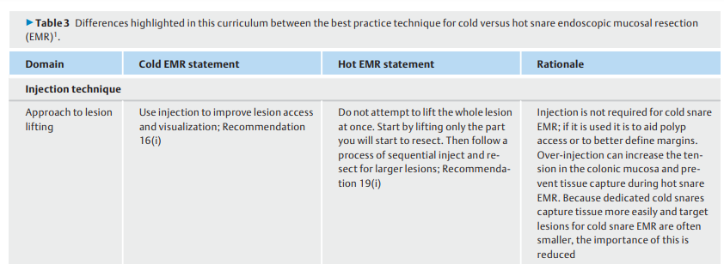

Slide 47
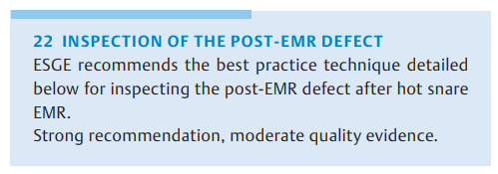

Slide 48
If removal of the snare is difficult, visible polyp tissue should not be coagulated, instead it should be removed using a different snare or an avulsion technique prior to considering ablation.
After any visible polyp has been removed from the defect margin, a thermal ablation technique (e. g. STSC; ERBE soft coagulation effect 4, 80W) should be applied to the entire margin ensuring a rim of 1–3mm of complete mucosal ablation. The thermal ablation technique should only be applied to tissue with a prior submucosal injection to ensure safety (▶Fig. 2, image A5).

Slide 49
The submucosa of the defect should be further inspected for bleeding vessels (▶Fig. 2, image D6). These should be coagulated
The submucosa of the defect should be further inspected for large herniating vessels. The weight of available evidence suggests that, if vessels are not bleeding, they do not need to be coagulated

Slide 50
Significant fibrosis in the submucosal plane should be noted. This may represent a benign cause such as prolapse, may be an intrinsic feature of a nongranular LNPCP, or may represent evidence of submucosal invasion
Topical application of the injectate (containing a chromic dye) can be helpful for areas of the defect where there is uncertainty as to the presence of muscularis propria injury

Slide 51
Photodocumentation of all areas of the post-EMR defect helps to assess completeness of resection (▶Fig. 2, image D1) and facilitates learning if an adverse event occurs later. It may also be useful for medicolegal purposes.

Slide 52
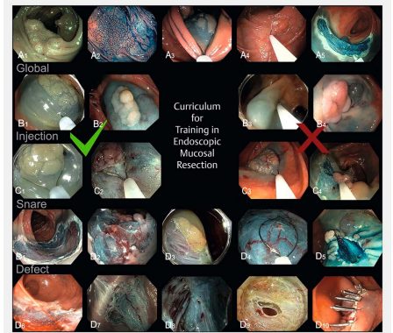

Slide 53
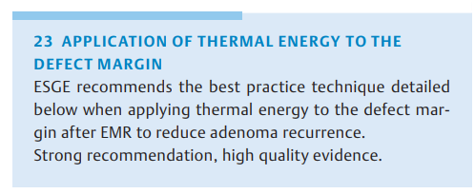

Slide 54
The technique for STSC of the post-EMR margin is as follows:
▪ extend the tip of the snare 2–3mm beyond the catheter sheath
▪ use the scope and the snare tip as one device, do not move the catheter in and out of the channel
▪ apply pulses of soft coagulation using a light-touch technique to the margin of the defect, ideally over injected tissue
▪ aim for a rim of 2–3mm of ablated tissue at the margin
▪ ensure that the margin is ablated around the full circumference without gaps.
Confirmation of the technique is visual identification of the white appearance of the mucosa after application

Slide 55
Comment Evidence from several randomized studies suggests that thermal ablation of the defect margin after EMR significantly reduces recurrence at first surveillance colonoscopy, by approximately 4-fold in expert hands .Prospective observational studies and meta-analyses have confirmed this finding.

Slide 56
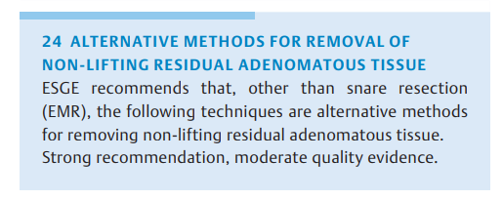

Slide 57
Cold avulsion (using a standard biopsy forceps), then thermal ablation using soft coagulation (ERBE effect 4, 80W) to the avulsion bed using the snare tip.
Non-lifting tissue should be completely removed prior to application of soft coagulation.

Slide 58
(ii)There are many other published techniques to manage residual adenomatous tissue. Such techniques include, but are not restricted to, hot avulsion [125], forced argon plasma coagulation [126], and more resource-intensive techniques, such as endoscopic submucosal dissection [127–129] or full-thickness resection [12]. These techniques are outside of the scope of this curriculum and are often not cost-effective in this situation

Slide 59
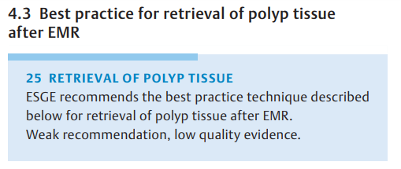

Slide 60
Use of an endoscopic retrieval net is recommended when performing piecemeal polypectomy. Level of agreement 92 %.
If performing en bloc resection, the snare can be used to retrieve the resected polyp tissue.
Suction of transected tissue through the endoscope channel for retrieval may interfere with histologic interpretation.

Slide 61
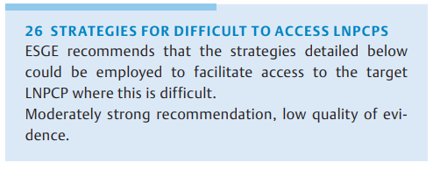

Slide 62
Patient factors
Change patient position to respect the influence of gravity on fluid/blood (away from the lesion) and to optimize views. Level of agreement 96 %.
(ii) Optimize patient sedation. Level of agreement 94 %.
(iii) Administration of antispasmodics. Level of agreement 93 %

Slide 63
Insertion challenges
(iv) Excellent basic colonoscopy technique to arrive at the lesion without looping. Level of agreement 96 %.
(v) Use of external pressure to prevent loop formation during insertion. Level of agreement 86 %.
(vi) Use of different endoscopes with different lengths, stiffness, and tip-bending properties etc. (e. g. pediatric colonoscope, gastroscope, balloon-enteroscope). Level of agreement 93 %.

Slide 64
Insertion challenges
An endoscopist must first be able to reach the LNPCP before resection can be attempted. Insertion challenges can result from: fixed segments of colon; long mobile colons with complex loop formation; patients with a hypersensitive colon and poor tolerance of any distension or colonic stretch stimulation; or previous abdominal/pelvic surgery.
A range of endoscopic instruments may help mitigate some of these problems
a slimmer flexible instrument in a fixed or narrowed colon,
a stiffer or longer scope in redundant loopy colons).
The underwater insertion technique is another option for improving successful intubation, helping to reduce distension and patient discomfort, improving control of loops and improving lubrication

Slide 65
Polyp characteristics
Specific types of LNPCPs can have an increased association with fibrosis, in particular nongranular LNPCPs .
A larger exophytic component of a lesion is associated with an increased size in feeding vessels.
The distal rectum is also a highly vascular area and increased care to ensure hemostasis during resection is needed for polyps in this location.

Slide 66
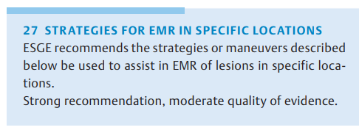

Slide 67
The position of the patient is critical, using gravity to maximize the luminal view and access to the lesion.
the right lateral position for lesions in the sigmoid, descending colon, splenic flexure, and cecal pole;
the left lateral position for lesions in the hepatic flexure and ascending colon;
the supine position for lesions in the transverse colon;
and the prone position if other positions are difficult in a patient with a long redundant colon, particularly for lesions in the rectosigmoid

Slide 68
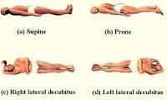

Slide 69
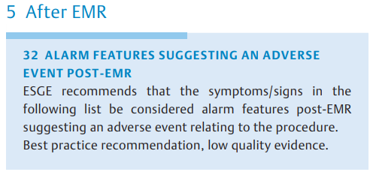

Slide 70
Persistent abdominal pain despite simple analgesics
(ii) Persistent abdominal distension associated with abdominal pain.
(iii) Hemodynamic instability/shock (fever, tachycardia, hypoxia etc.)
(iv) Peritonism on clinical examination
(v) Persistent large-volume rectal bleeding. Level of agreement 97 %.

Slide 71
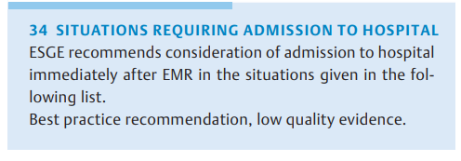

Slide 72
A highly co-morbid patient.
(ii) A patient who is elderly and/or lives alone without support (especially if sedation has been used
(iii) A patient requiring early re-introduction of anticoagulation (e. g. metal mitral valve).
(iv) Intraprocedural perforation with observed fecal peritoneal contamination or incomplete confidence of closure
(v) Significant periprocedural bleeding, even if controlled.
(vi) Abdominal pain that does not resolve with simple analgesics (e. g. intravenous paracetamol).
(vii) Unexplained fever/tachycardia.

